Slide 1
Introduction to Data Science

Slide 2
Environment Set-up
Anaconda 3
Create Course Folder
$ jupyter notebook

Slide 3
The Data Science Process
1. Identify the Question
2. Get the Data
3. Clean the Data
4. Explore the Data
5. Refine the Data
6. Model the Data
7. Communicate the Results

Slide 4
Inferential Statistics

Slide 5
Sampling

Slide 6

Population
200,000

Slide 7

Population
200,000
Sample
1000

Slide 8
Population
200,000
Sample
1000
30%
70%

Slide 9
Central Limit Theorem

Slide 10
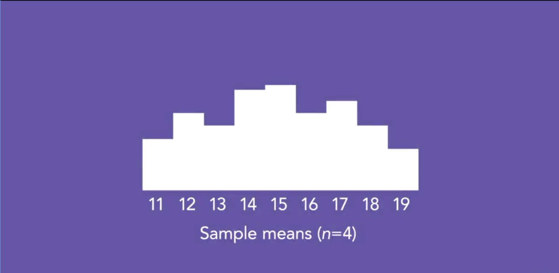

Slide 11
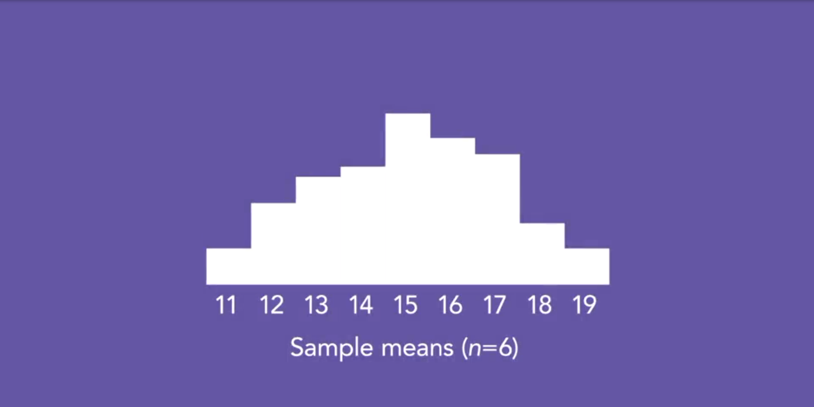

Slide 12
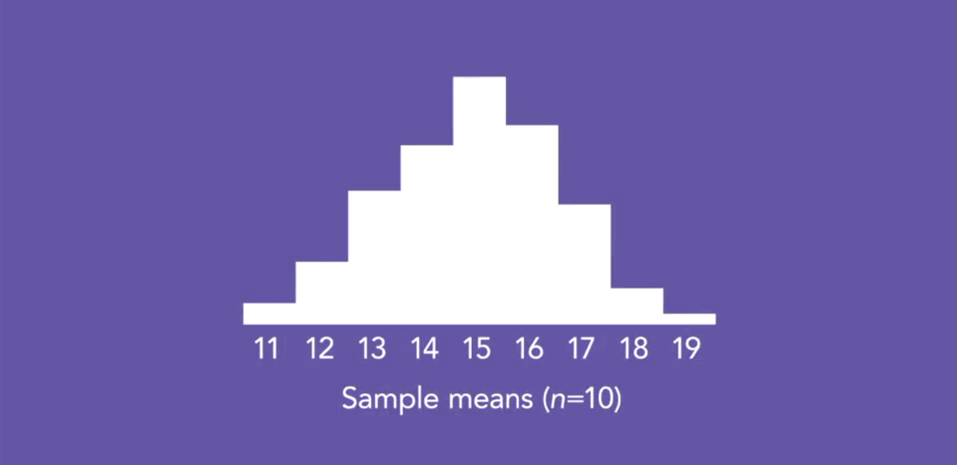

Slide 13
Standard Error

Slide 14
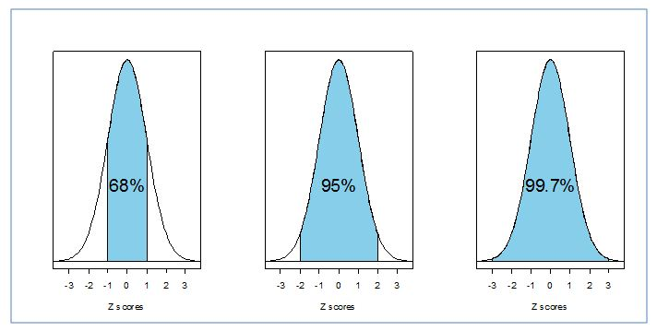
Empirical Rule

Slide 15
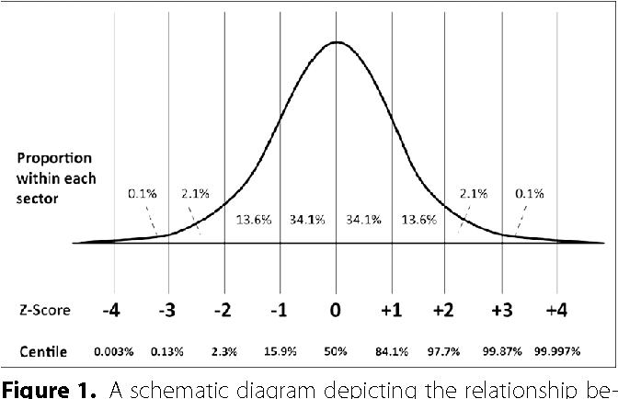

Slide 16
Confidence Interval

Slide 17
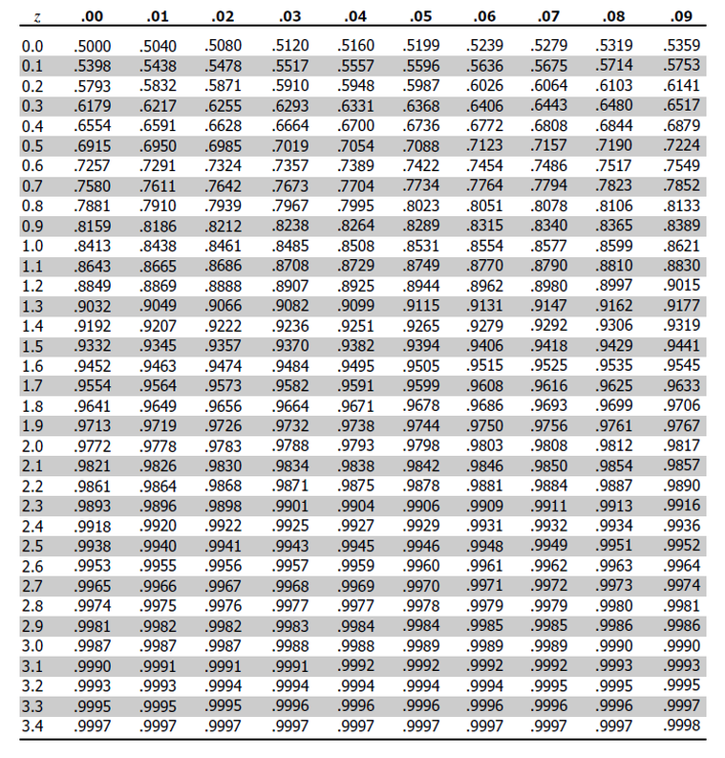

Slide 19
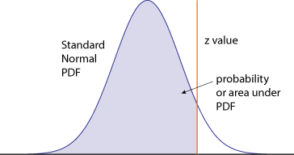

Slide 20
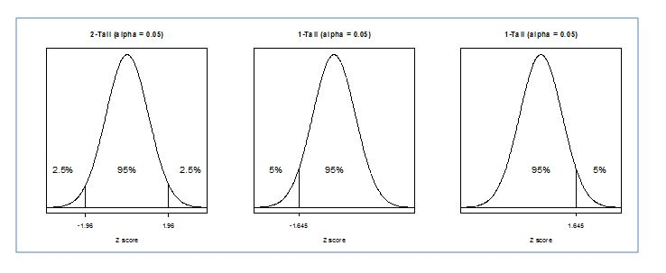

Slide 21

Sampling Error

Slide 22
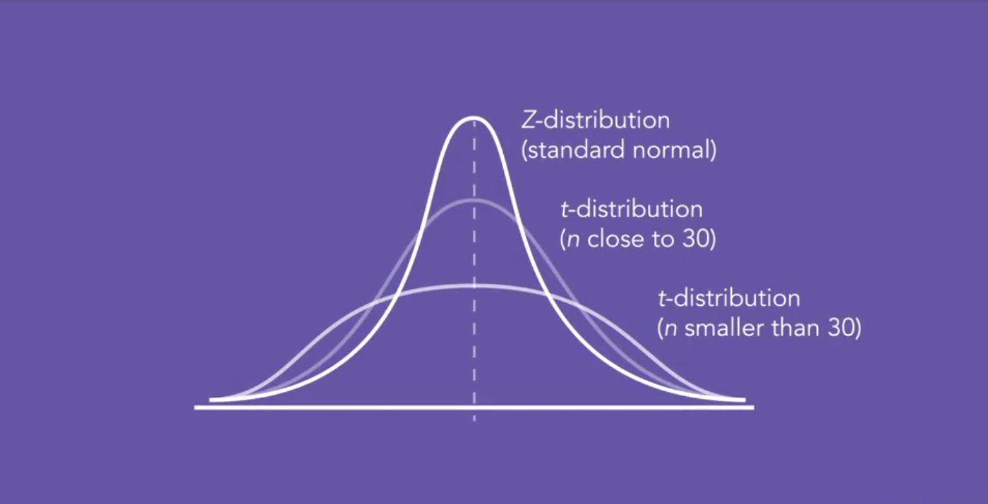

Slide 23
Null Hypothesis
H0: No systematic effect
And random sampling error
is the only explanation
Alternative Hypothesis
Ha: Systematic effect

Slide 27
Sample size
How the sample was chosen

Slide 28

Antony Ross
antony-ross
antonyross2k@gmail.com

